Slide 1
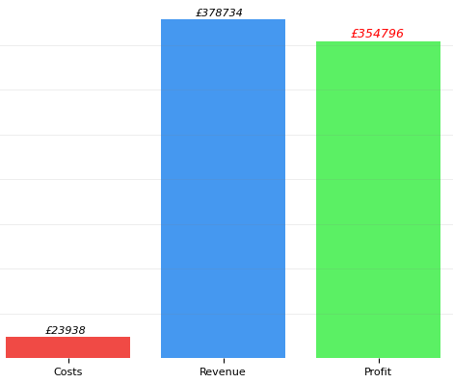
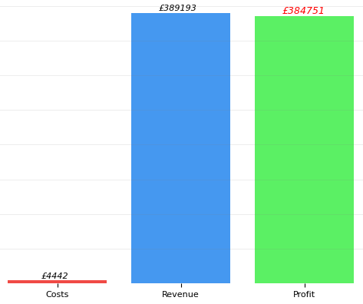

PROFITABILITY ANALYSIS
B2B
Key points
B2C has higher profitability than B2B
The costs of B2B are much higher than B2B sales
We recommend that you expand your products into the B2C market.
B2C

